Slide 1
Modeling and simulation of an armature-controlled motor
Emanuel Cruvinel

Slide 2
Overview
We are going to model and simulate an armature-controlled motor using Simscape
Current on motor and shaft speed will be measured

Slide 3
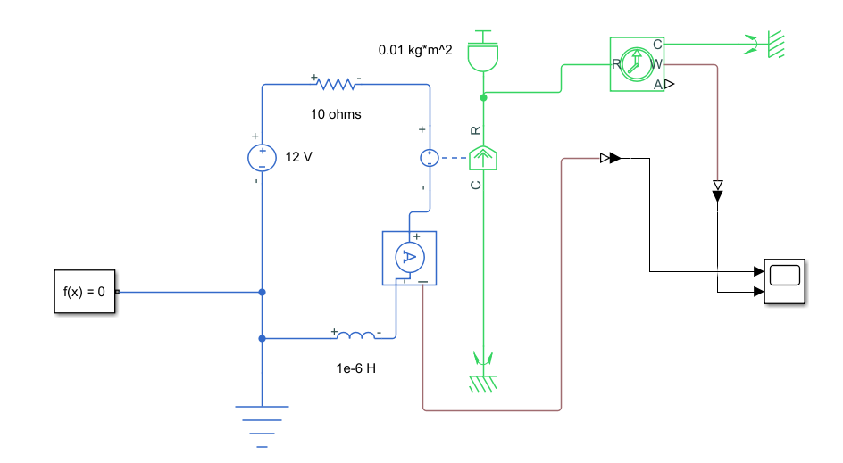
Model

Slide 4
Parameters
R = 10 ohms
DC voltage source = 12V
L = 1e-6 H
Total Inertia (I)= 0.01 kg*m^2
K = 0.1 V/rad/s

Slide 5

Model ODE sytem
$$\left\{\begin{aligned}L\frac{di}{dt}+Ri+K=V \\ I\frac{dω}{dt} −Ki=0\end{aligned}\right.$$

Slide 6
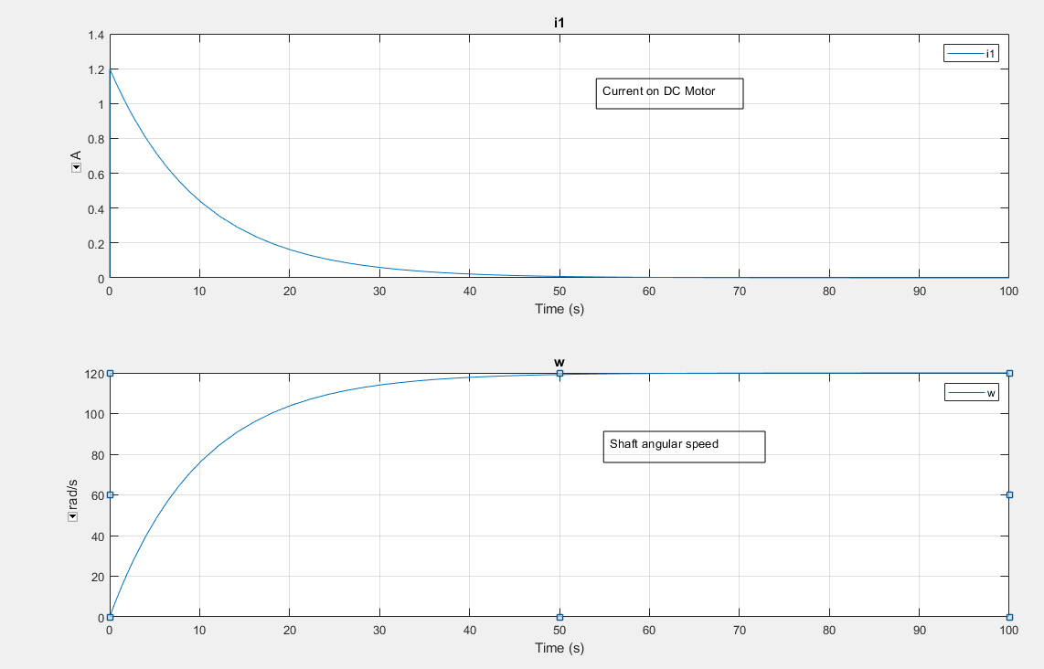
Results

Slide 7
Conclusion
The model does satisfy the analytical equation
The model solution is equivalent to the motor ode system

